Slide 1

Autonomous Ash-Dam Safety Node
Cyber-physical telemetry and a live 3D digital twin for coal-ash dams
Domain 3 · Power Station Ash Dam & Industrial Safety
Notes:
[0:00-0:15] Open strong, do not read the slide. 'We are AshX. We stop coal-ash dams from failing by watching them continuously and acting automatically when they start to go wrong.'

Slide 2
THE PROBLEM
Ash dams fail from the inside out
1
90% piles up
2
Heavy rainfall
3
Pressure spikes
Ash stored wet; dams grow taller and heavier every year
Seasonal storms load the dam with more water
Saturation raises pore pressure and destabilises the wall
4
Monitoring blind spot
5
The wall breaches
6
Toxic contamination
Manual checks are weekly : days pass between readings
Failure can run from trigger to collapse in hours
Arsenic, lead and mercury into water and soil for decades
Notes:
[0:15-0:50] Walk the chain, do not read every box. 'Ash is stored wet. Rain loads the dam. That raises internal pressure — which is what actually breaks the wall. Nobody sees it because inspection is weekly. Then it breaches, and the contamination lasts decades.' Land on: the cause is INTERNAL PRESSURE, and nobody is watching it.

Slide 3
WHY NOW
This is not hypothetical. It is Mpumalanga.
4.4
34 Mt
2020
tailings dam failures per year, globally
of coal ash a year from Eskom — only 7–10% reused
Eskom shut Camden (1,600 MW) over collapse risk
Jagersfontein, September 2022 — a South African tailings dam failed, releasing a mudflow that destroyed homes and killed. Different commodity, identical failure mechanism.
Sources: Science (2019) · Metals (2022) · Moneyweb · Global Energy Monitor
Notes:
[0:50-1:15] Hit the numbers fast. The key beat: Eskom ALREADY took 1,600 MW off a strained grid because an ash dam might collapse, and a South African dam already failed and killed someone in 2022. This is live, and it is in our province.

Slide 4
OUR SOLUTION
A low-cost IoT node that senses the water driving internal pressure, detects a dangerous rate of rise in real time, and autonomously opens a bypass gate and starts a relief pump — while streaming live data to a 3D digital twin.
SENSES
DECIDES
ACTS
Continuously
On-device, in milliseconds
Physically, with no human
Ultrasonic level readings , filtered on-device to kill false alarms.
Two triggers: absolute level, and rate of rise, so a rainfall surge trips the alarm early.
Gate opens, pump drains the dam, siren and warning light fire on site.
All three happen on the device — in the seconds that decide whether the dam holds.
Notes:
[1:15-1:45] This slide must be crystal clear. Say the box almost verbatim, then the three words: SENSES, DECIDES, ACTS. Emphasise 'rate of rise' — that is the early warning, and it is what makes us smarter than a float switch.

Slide 5
HOW IT WORKS
1
SENSE
2
FILTER
3
DECIDE
Ultrasonic sensor reads the dam level
Median filter removes electrical noise
ESP32 checks level and rate of rise
4
ACT
5
TRANSMIT
6
VISUALISE
Gate opens, pump runs, siren sounds
MQTT publishes live telemetry
3D digital twin updates in the browser
Notes:
[1:45-2:10] Trace the chain with your hand. Finish on the grey bar — it sets up the next slide, which is our biggest differentiator.

Slide 6
OUR DIFFERENTIATOR
Cut the network. It still saves the dam.
Dams sit in remote places, and storms take connectivity down exactly when risk is highest. So we never put the cloud in the safety loop.
Cloud-dependent systems
AshX
Alerting stops when the link drops
Waits for a human to read a screen
Latency measured in minutes
Fails exactly when it matters most
Gate opens without connectivity
Pump drains the dam automatically
Decision in milliseconds, on-device
Telemetry resumes when the link returns
Notes:
[2:10-2:30] Your strongest technical point — slow down. Judges love edge autonomy. If demoing live, this is where you pull the network and show the gate still opening.

Slide 7
TECHNOLOGY STACK
Tech-Stack
ESP32 NodeMCU
Edge computing
Dual-core with native Wi-Fi — runs filtering and decisions locally, cheap enough to deploy densely.
MQTT over WebSockets
Telemetry
Publish/subscribe with a few bytes of overhead — built for constrained devices on poor links.
Firebase Realtime DB
Cloud analytics
History, alert logs and trend analysis with no backend server to build.
Three.js (WebGL)
3D digital twin
Navigable 3D in the browser, loading in tens of KB, live data binding in the same script.
Arduino C++
Firmware
Deterministic hardware timing and mature ESP32 library support.
Three.js over Unity: WebGL is the browser API, Three.js is the standard library on top of it — WebGL without hand-written shaders or Unity's multi-megabyte download.
Notes:
[2:30-2:50] Do not read the table. Say: 'Every layer of the required framework is covered — edge, transport, cloud and 3D.' Keep the Three.js line ready for a technical judge in Q&A.

Slide 8
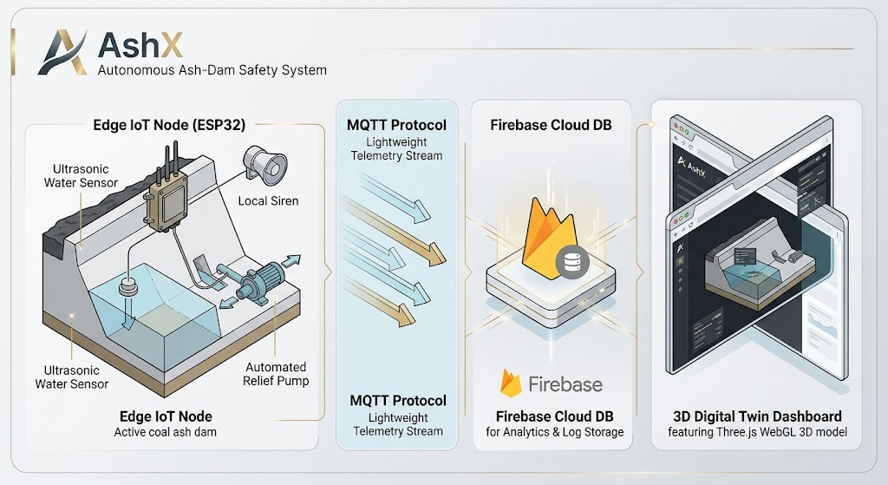

Slide 9
TARGET MARKET
TIER 1
TIER 2
TIER 3
TIER 4
National power utilities
Mining houses
Insurers & underwriters
Municipal wastewater
Eskom, Mpumalanga stations
Gold, platinum, coal tailings
Industrial risk pricing
Sludge and overflow control
They have already taken 1,600 MW offline over this exact risk. The problem is acknowledged and budgeted.
Identical failure mechanism, ~20,000 facilities globally, and real post-Jagersfontein pressure.
They already price tailings risk. A monitored dam is a measurably different risk profile.
Same physics, same overflow problem — a large adjacent market with no new engineering.
Notes:
[3:05-3:35] Judges want to know WHY these people. Give the reason, not the segment. Tier 1 has already proven they act on this risk. Tier 3 is the clever one — insurers pay for reduced risk, so someone other than the polluter helps fund the monitoring.

Slide 10
PRACTICALITY
Practicality
USABLE
SCALABLE
AFFORDABLE
Red or green — readable at a glance, no training
The 3D twin makes a dam legible to non-engineers
Siren and warning light need no screen at all
Installs in hours, not weeks
Commodity parts — deploy dozens, not one or two
One firmware covers ash dams, tailings and sludge
MQTT carries many nodes on a single broker
Cloud scales with no new hardware on site
Off-the-shelf components, no specialist rig
No proprietary installation contractor needed
Complements existing geotechnical instruments
Puts monitoring on sites that have none at all
Built in 18 hours from parts anyone can buy — which is exactly why it can be deployed at scale.
Notes:
[3:55-4:15] Answer the three adjectives head on. Punchline is the bottom line: being cheap and simple is not a weakness of the prototype — it is the reason it can be deployed across thousands of unmonitored structures.

Slide 11
WHY IT MATTERS
Why it matters?
For the community
The skills Mpumalanga needs
Families live downstream — a breach threatens homes and lives, not just habitat
Groundwater contamination lasts decades; arsenic and lead do not wash away
Early warning buys the minutes that decide whether people get out
Water security where mining and farming share the same rivers
A coal economy facing a just transition needs new technical work, not only clean-up
Every node deployed needs local people to install, calibrate and maintain it
IoT, telemetry and digital twins transfer into agriculture, water and logistics
A local monitoring industry — instead of imported consultants and hardware
This is bigger than just conservation:
Solving a Mpumalanga problem with Mpumalanga hands builds the capability the province needs after coal.
Notes:
[4:15-4:45] Slow right down — this decides whether judges remember you. Key sentence: this is not an environmental nice-to-have, it is public safety AND an industrial skills pipeline for a province whose coal economy is ending. Deliver the closing line looking at the judges, not the screen.

Slide 12
Sense · Filter · Visualise
Our ask: one instrumented pilot on a Mpumalanga ash dam.
Continuous monitoring where there is currently none.
Notes:
[4:45-5:00] End on the ask, not a thank-you. Say it, then stop talking and take questions. Silence after the ask reads as confidence.

